Slide 1
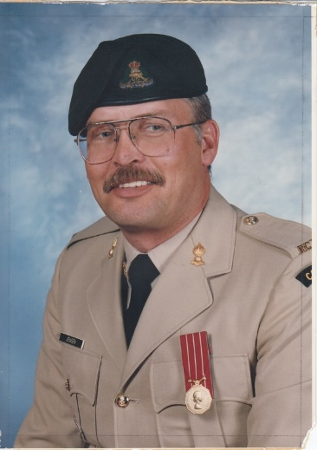
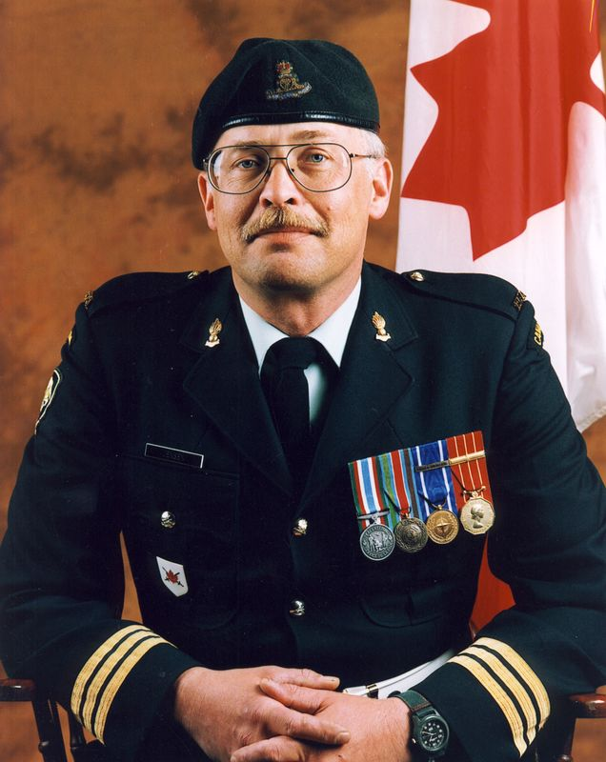
Leon Jensen OMM CD
Enrolled 15th Field Artillery Regiment RCA Oct 1970
Regimental Sergeant Major 1986-1988
Commanding Officer 1998-2001
President Vancouver Artillery Association
Vice-President Royal Canadian Artillery Association
Webmaster – www.vancouvergunners.ca

Slide 2
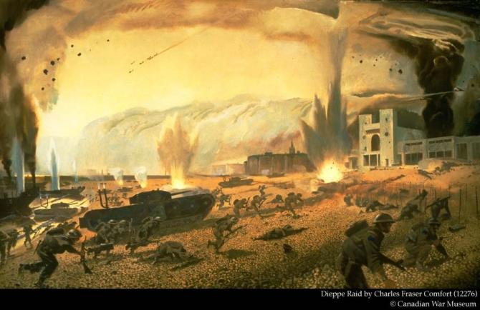
World War II

Slide 3
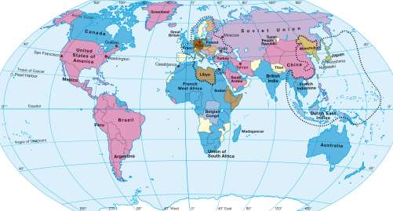

Slide 4
The Republic of China and the Empire of Japan are involved in the early stages of the third year of armed conflict between them during the Second Sino-Japanese War.
1 Sep - The invasion of Poland by Nazi Germany starts.
2 Sep - The United Kingdom and France issue a joint ultimatum to Germany.
3 Sep - Great Britain and France declare war on Germany.
3 Sep - Within hours, SS Athenia, a British cruise ship is torpedoed.
10 Sep - Canada declares war on Germany.
17 Sep - The Soviet Union invades Poland from the East.
3 Oct - British forces move to the Belgian border.
30 Oct - The Soviet Union attacks Finland.
18 Dec - The first Canadian troops arrive in Europe.
9 Apr - Germany attacks Denmark and Norway.
10 May - Germany invades Belgium, France, Luxembourg and the Netherlands.

Slide 5
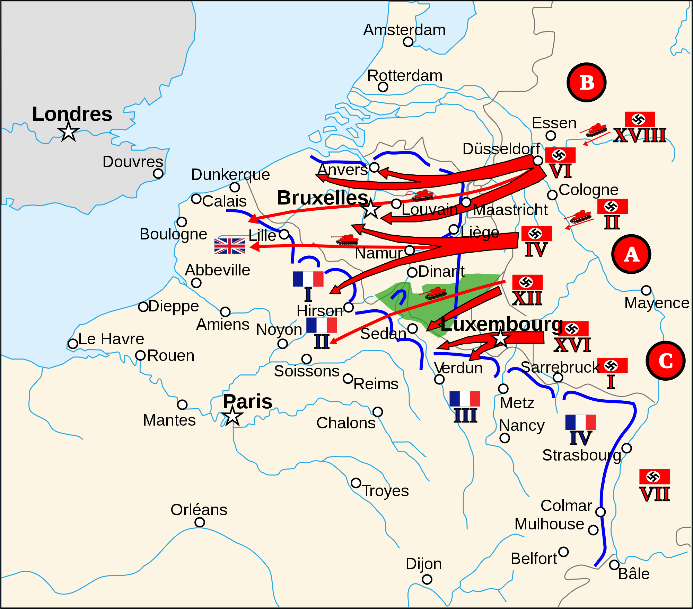

Slide 6
In March 1939 the Permanent Active Militia , Canada's full-time army had only 4,169 officers and men while the Non-Permanent Active Militia (Canada's reserve force) numbered 51,418 mostly armed with weapons from 1918.
The Convoy HX-1 departed Halifax just six days after the nation declared war. The 1st Canadian Infantry Division arrived in Britain on 1 January 1940

Slide 7
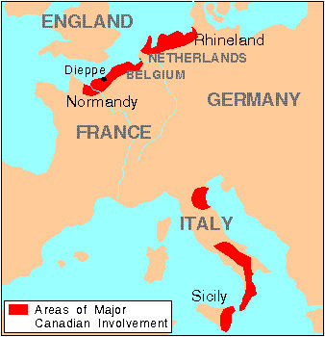
Battle of Britain
Battle of the Atlantic
Hong Kong
Aleutians
Southeast Asia and the Pacific

Slide 8
Battle Honours
South-East Asia, 1941
Hong Kong
North-West Europe, 1942
Dieppe
Sicily, 1943
Landing in Sicily
Grammichele
Piazza Armerina
Valguarnera
Assoro
Leonforte
Agira
Adrano
Catenanuova
Regalbuto
Centuripe
Troina Valley
Pursuit to Messina
Italy (with year dates)
Landing at Reggio
Potenza
Motta Montecorvino
San Nicola-San Tommaso
Termoli
Monte San Marco
Gambatesa
Campobasso
Baranello
Colle d'Anchise
Torella
The Sangro
Castel di Sangro
The Moro
San Leonardo
The Gully
Casa Berardi
Ortona
Point 59 or Torre Mucchia
Monte Camino
Monte La Difensa-Monte La
Remetanea
Monte Majo
Anzio
Cassino II
Gustav Line
Sant' Angelo in Teodice
Pignataro
Liri Valley
Hitler Line
Aquino
Melfa Crossing
Ceprano
Torrice Crossroads
Rome
Advance to the Tiber
Trasimene Line
Sanfatucchio
Arezzo
Advance to Florence
Cerrone
Gothic Line
Monteciccardo
Monte Luro
Borgo Santa Maria
Tomba di Pesaro
Coriano
Lamone Crossing
Misano Ridge
Rimini Line
San Martino-San Lorenzo
San Fortunato
Casale
Sant' Angelo in Salute
Bulgaria Village
Cesena
Pisciatello
Savio Bridgehead
Capture of Ravenna
Naviglio Canal
Fosso Vecchio
Fosso Munio
Coventello-Comacchio
Granarolo
Monte La Pieve

Slide 9
Battle Honours
Monte Spaduro
Southern France
Normandy Landing
Authie
Putot-en-Bessin
Bretteville-l'Orgueilleuse
Le Mesnil-Patry
Caen
Carpiquet
The Orne or The Orne (Buron)
Bourguebus Ridge
Faubourg de Vaucelles
St. André-sur-Orne
Maltot
Verrières Ridge - Tilly-la-Campagne
Falaise
Falaise Road
Quesnay Wood
Clair Tizon
The Laison
Chambois
St. Lambert-sur-Dives
Dives Crossing
Forêt de la Londe
The Seine, 1944
Dunkirk, 1944
Le Havre
Boulogne, 1944
Calais, 1944
Moerbrugge
Moerkerke
Wyneghem
Antwerp-Turnhout Canal
The Scheldt
Leopold Canal
Woensdrecht
Savojaards Plaat
Breskens Pocket
South Beveland
Walcheren Causeway
The Lower Maas
Kapelsche Veer
The Roer
The Ardennes
The Rhineland
The Reichswald
Waal Flats
Cleve
Moyland Wood
Goch-Calcar Road
The Hochwald
Veen
Xanten
The Rhine
Emmerich-Hoch Elten
Twente Canal
Zutphen
Deventer
Apeldoorn
Arnhem, 1945
Groningen
Friesoythe
Ijsselmeer
Küsten Canal
Delfzijl Pocket
Bad Zwischenahn
Oldenburg
Leer
Wagenborgen

Slide 11
Did The 15th Field Artillery Regiment RCA participate in the Second World War?
On 7 April 1938, The 15th Field Brigade, Royal Canadian Artillery was converted to the 15th Coast Brigade, Royal Canadian Artillery. On 26 August 1939, Volunteers for active service were called out and mobilized under Section 63 Militia Act.

Slide 12
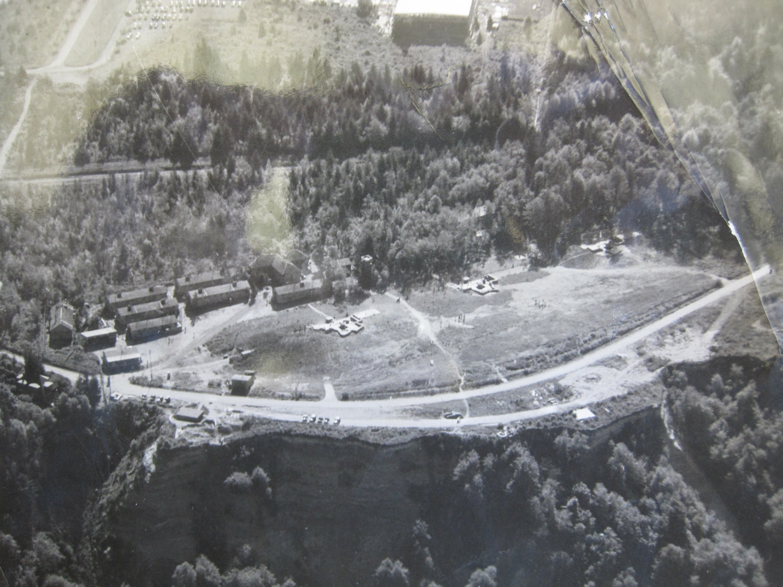

Slide 13
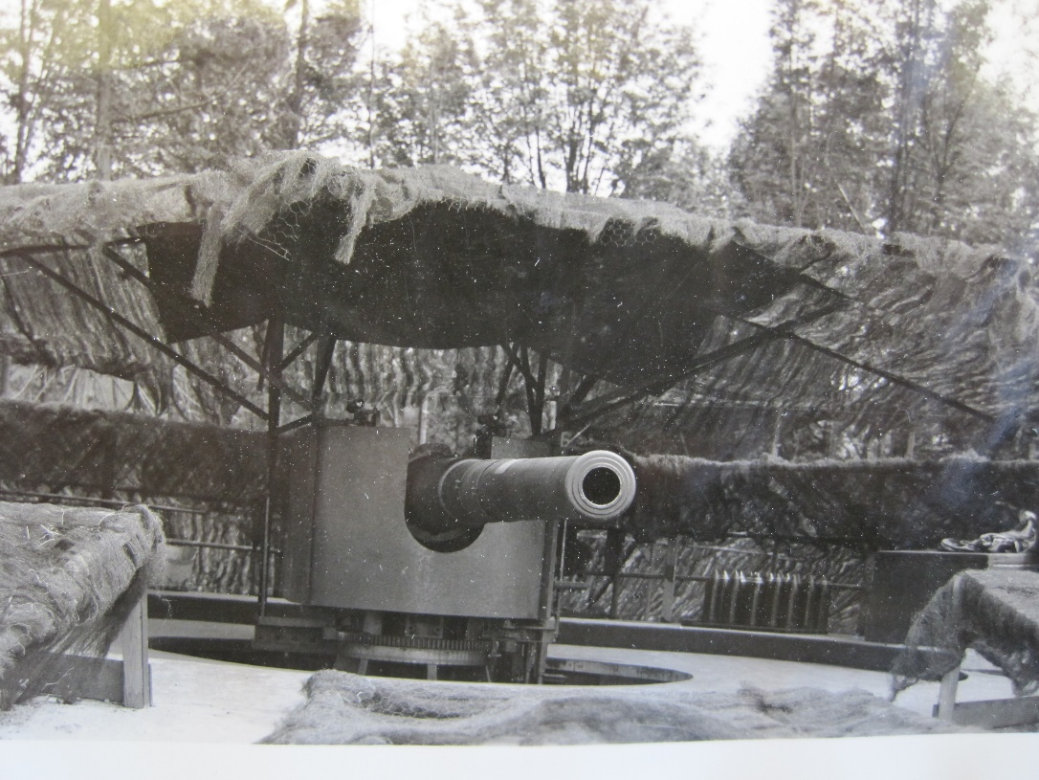
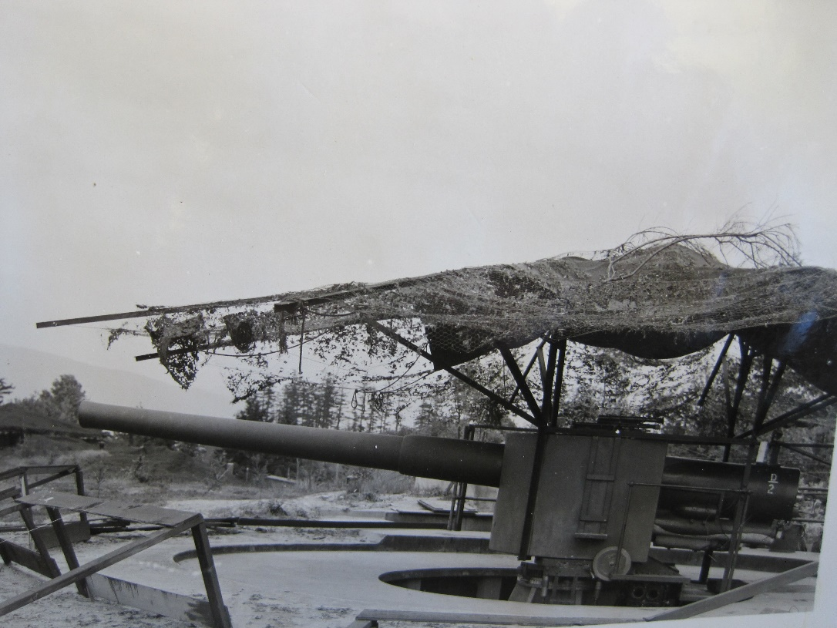
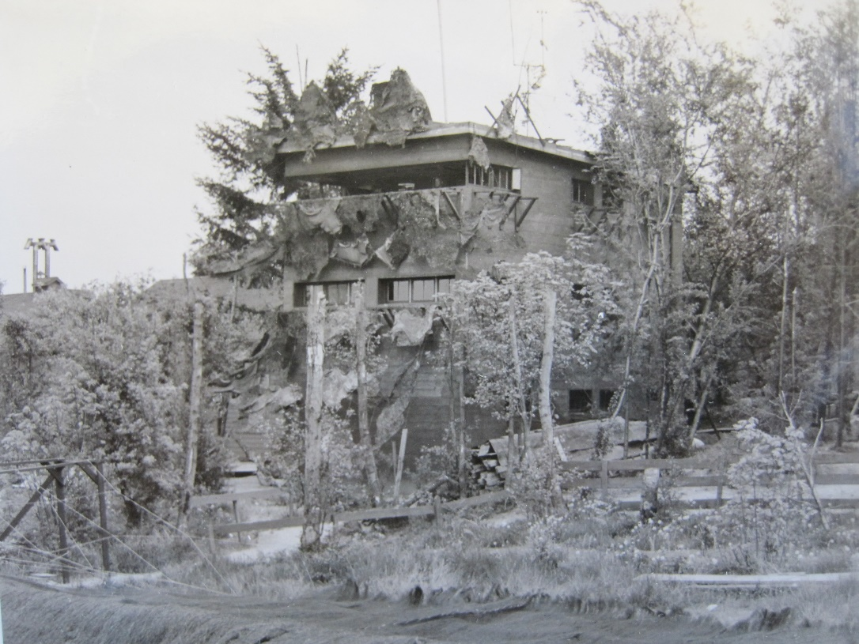
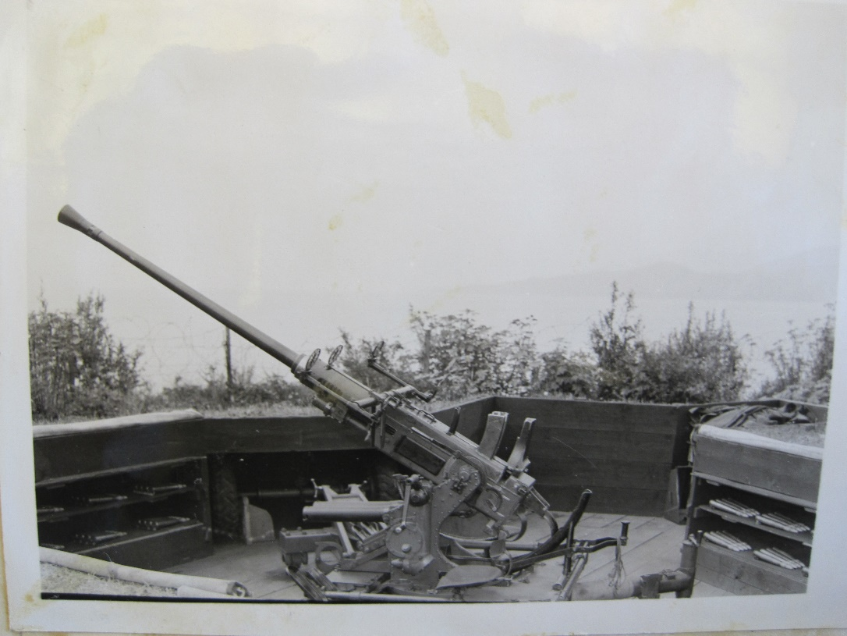

Slide 14
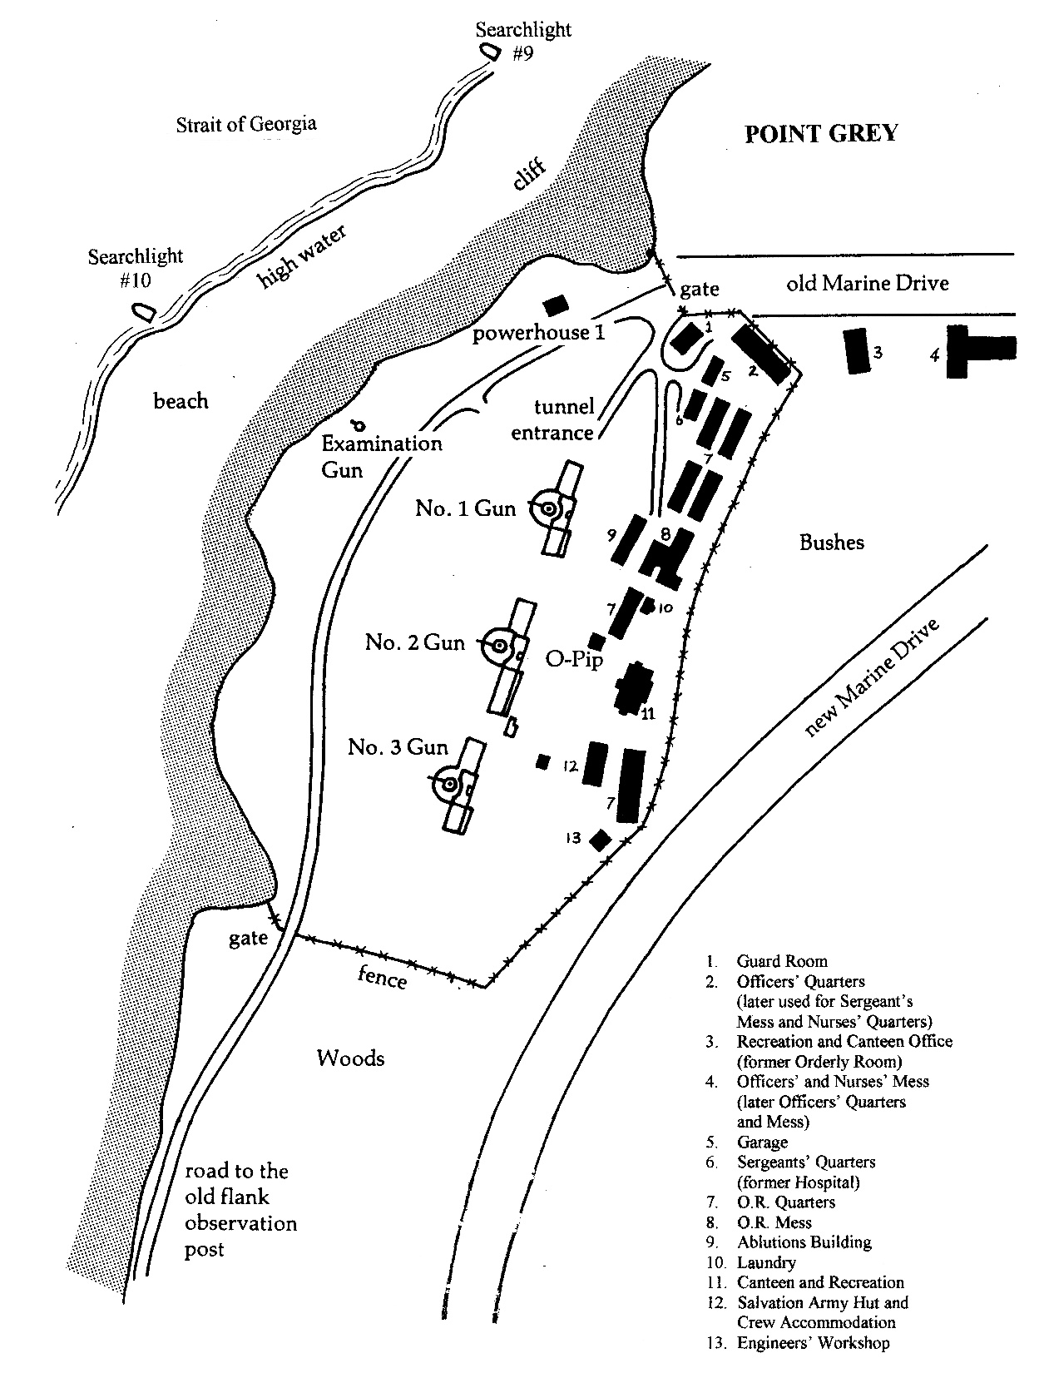

Slide 15
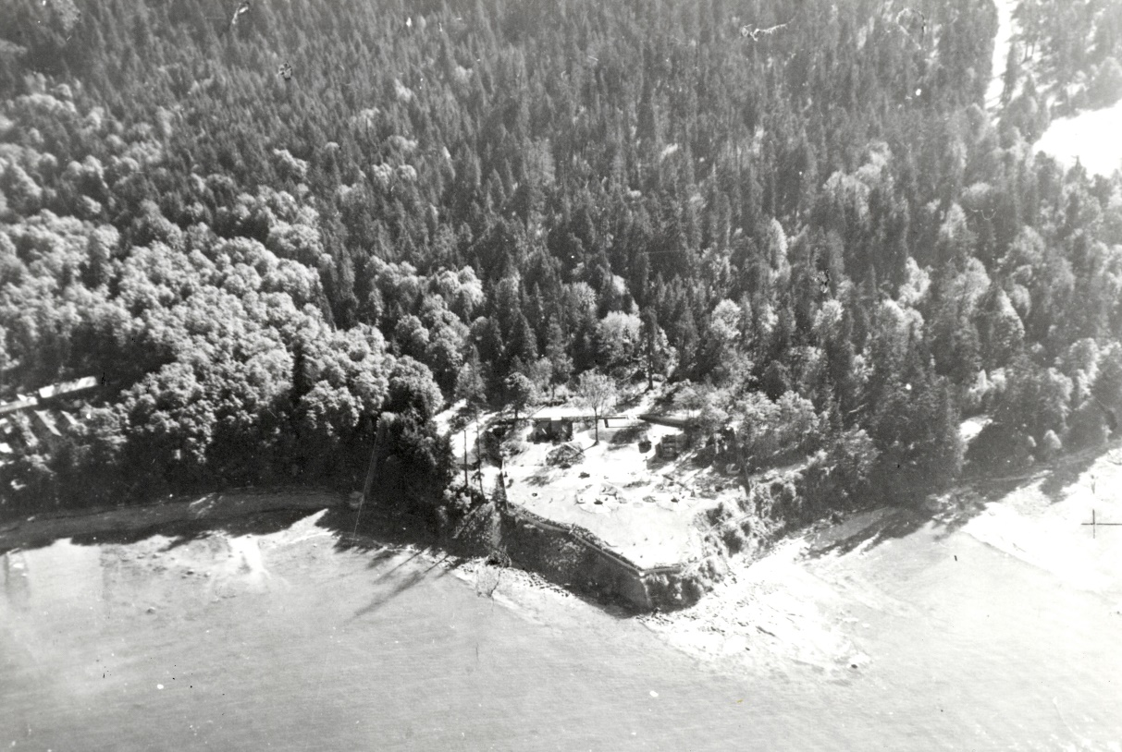
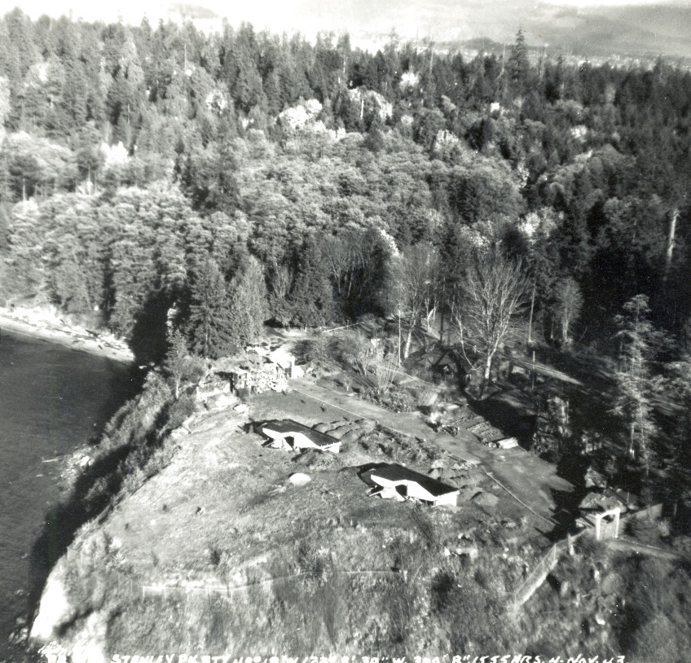
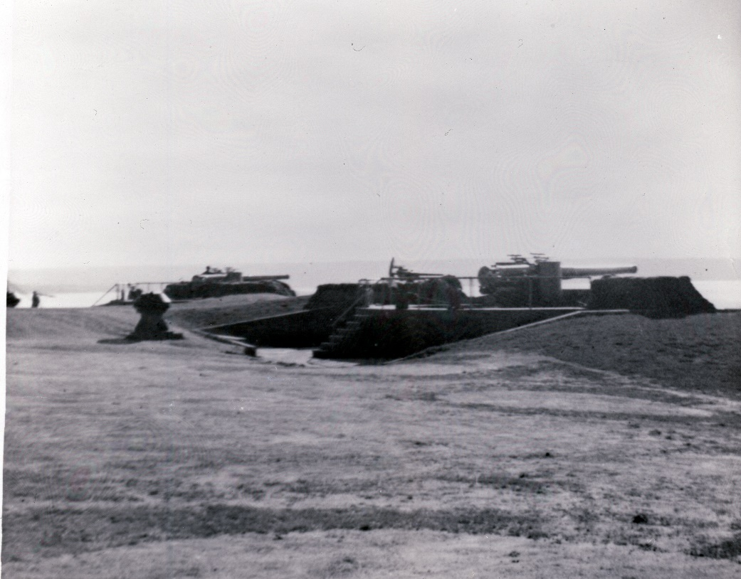
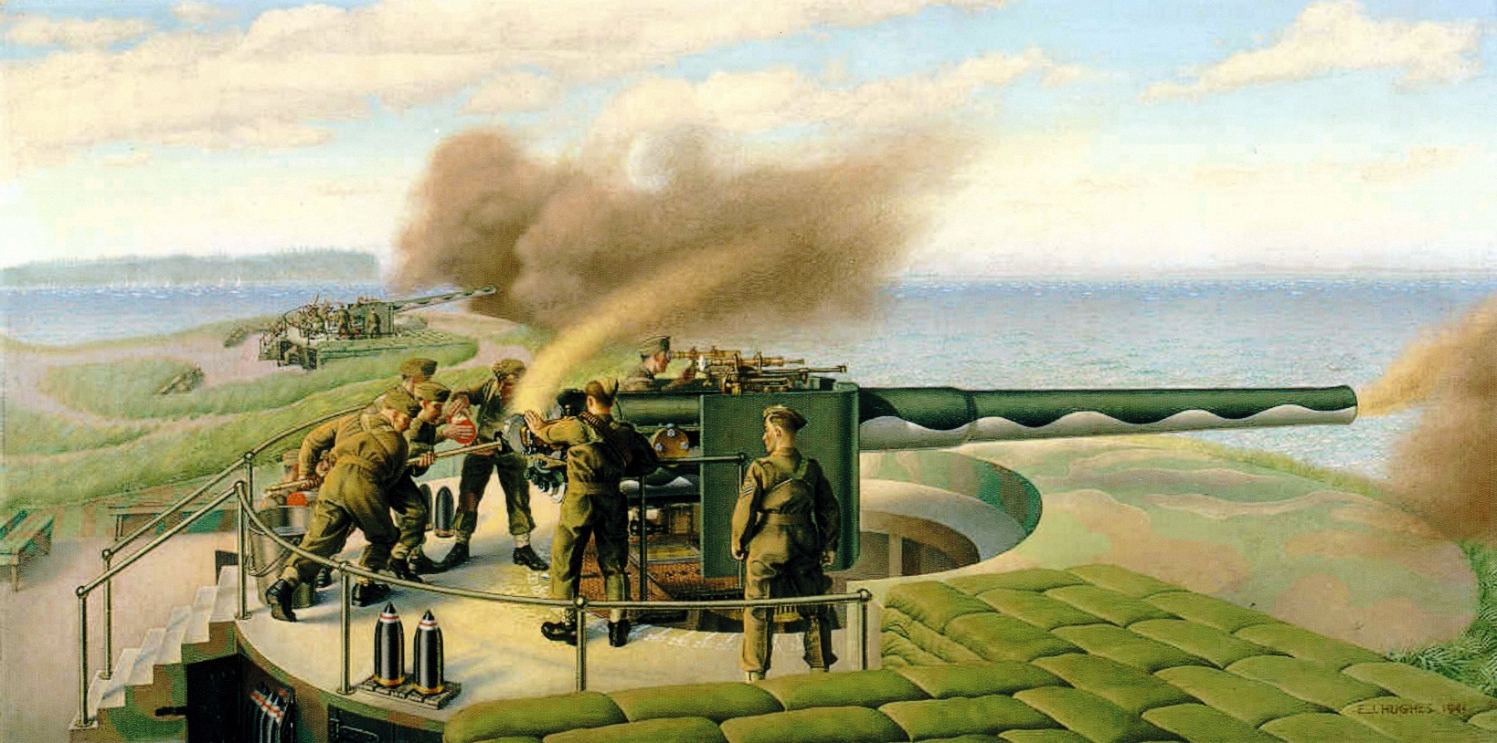

Slide 16
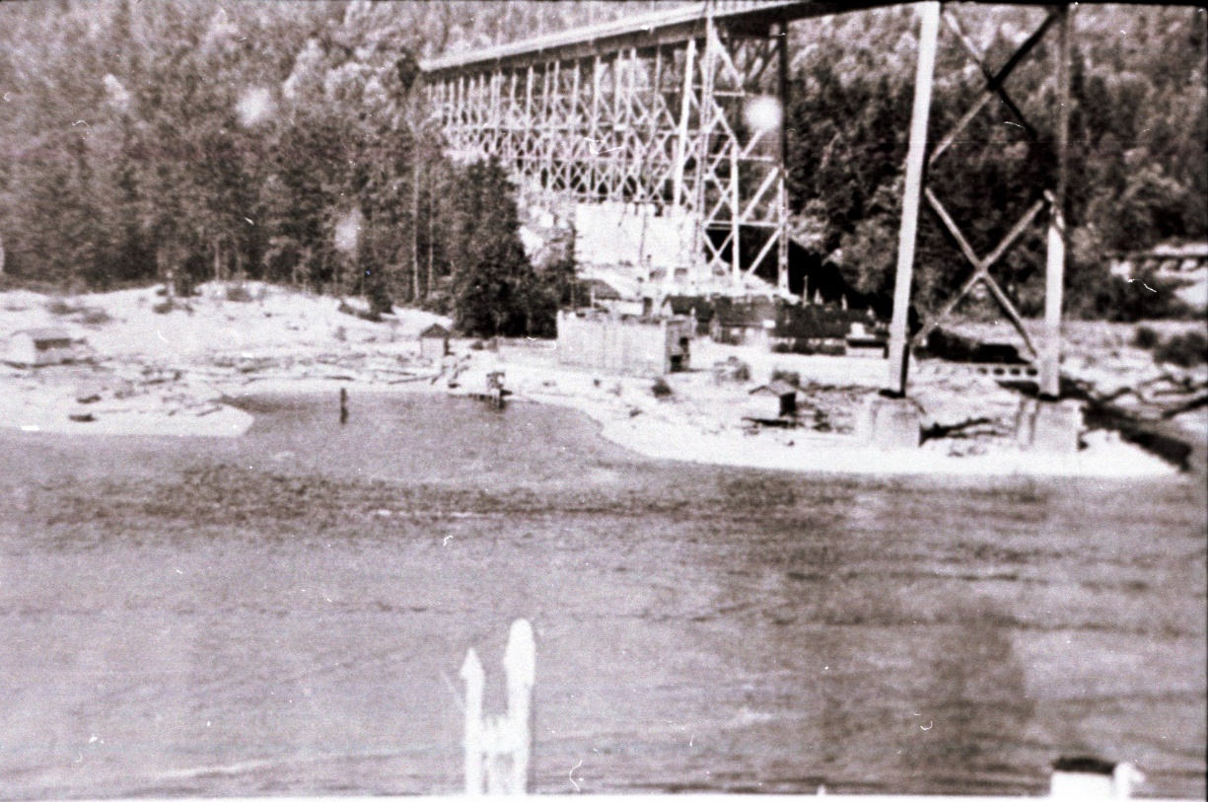
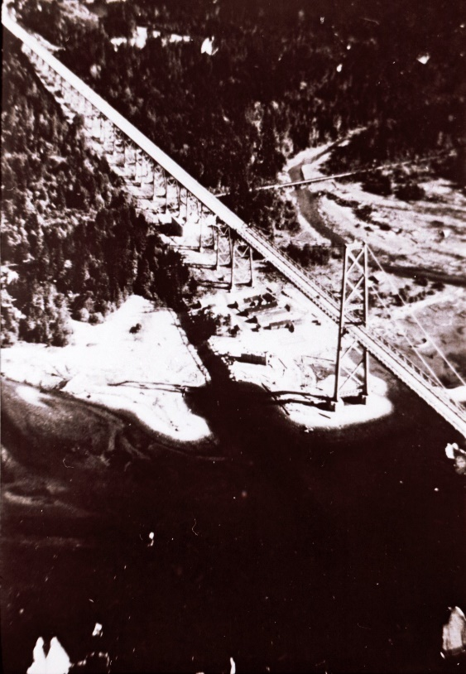
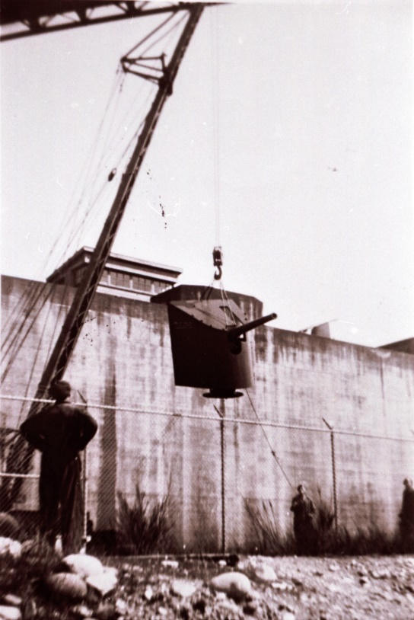
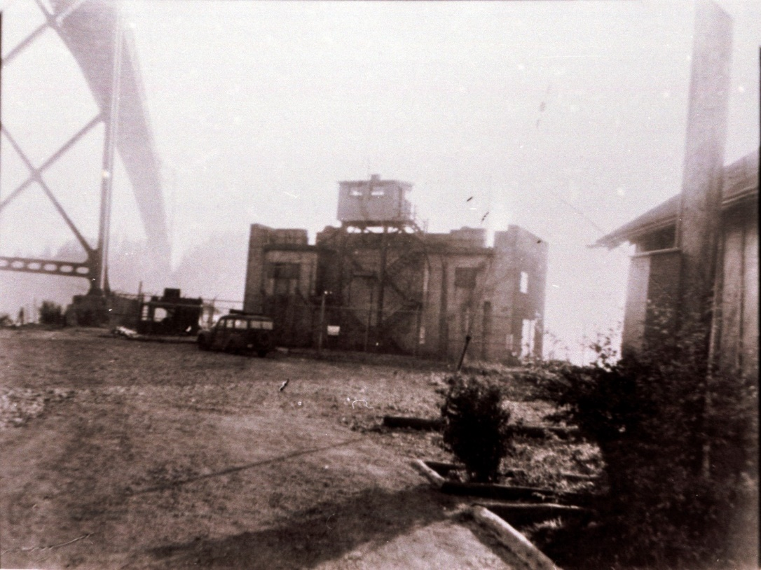

Slide 17
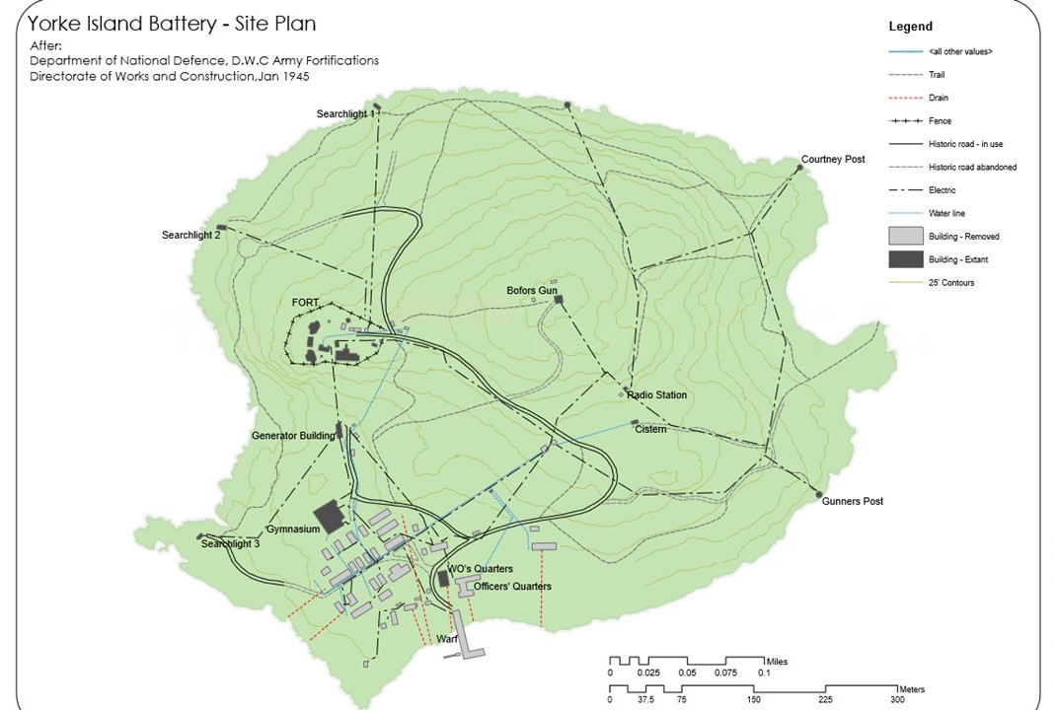
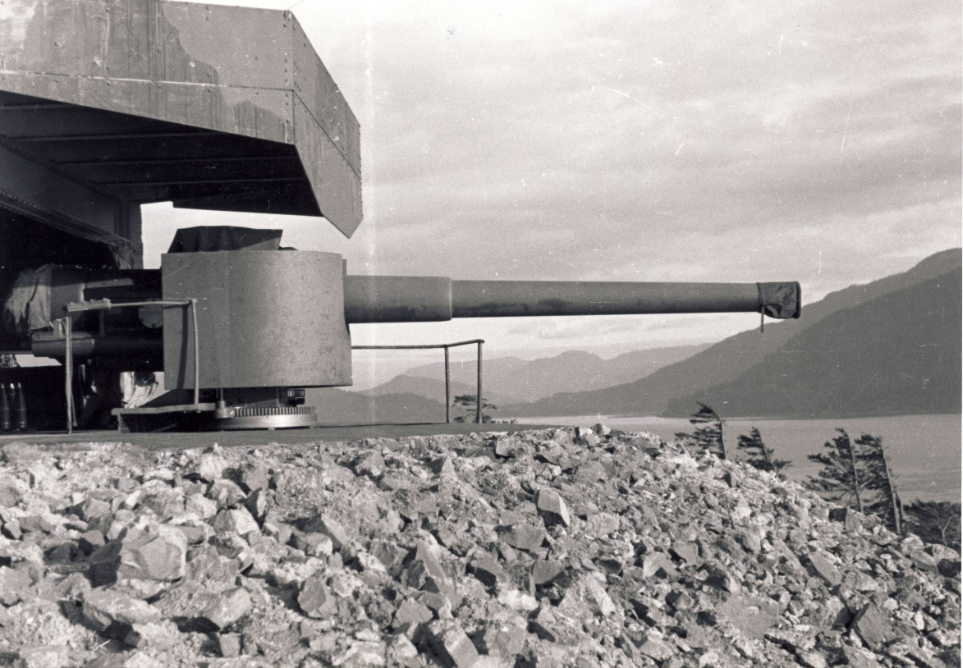
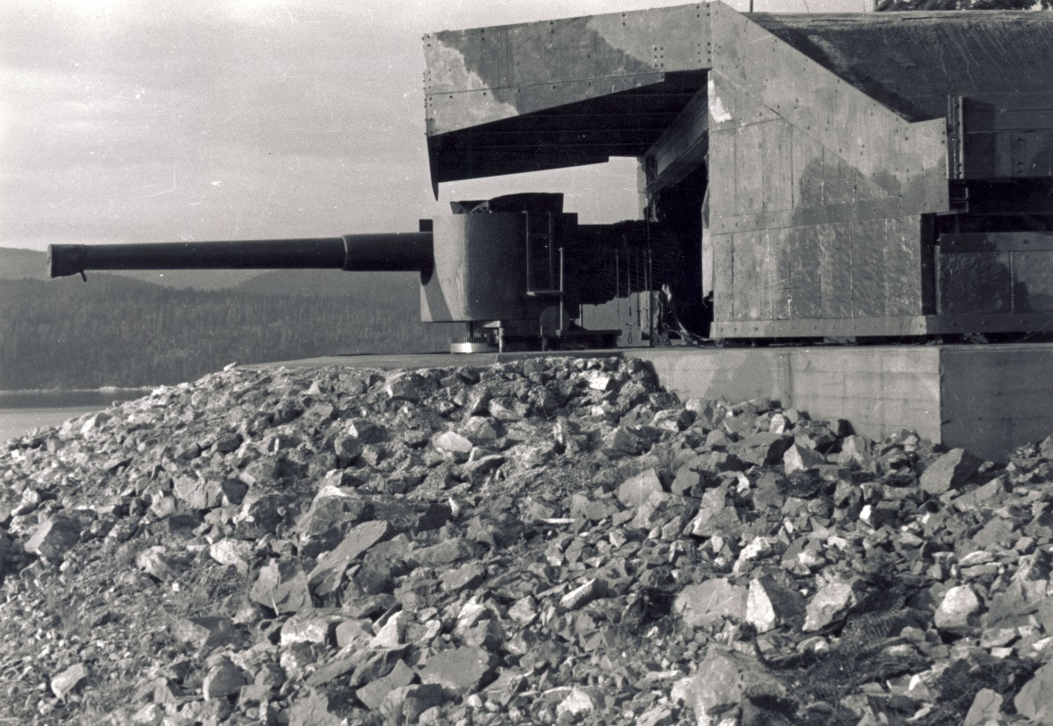

Slide 18
15th (Vancouver) Coast Brigade, RCA NPAM
39th Field Regiment, RCA NPAM
1st Anti-Aircraft Regiment, RCA CASF
15th Field Regiment, RCA CASF

Slide 19
Remembrance Day
Canada's total casualties - 44,000+ killed / 54,000 wounded.
1 September 1939 – 2 September 1945
We are the Dead. Short days ago We lived, felt dawn, saw sunset glow, Loved, and were loved, and now we lie In Flanders Fields
Lieutenant Colonel John McCrae

Slide 20
Lest we forget
Bombardier Norman Stanley Bajus 15th (Vcr) Coast Bde RCA 14 Sep 1939 15th (Vcr) Coast Bde RCA Accidental shooting Mountain View Cemetery, Vcr, BC
Gunner William Robert Smith 15th (Vcr) Coast Bde RCA 10 Jul 1940 15th (Vcr) Coast Bde RCA Accidental drowning Mountain View Cemetery, Vcr, BC
Bombardier Wallace Reece Brunt 15th (Vcr) Coast Bde RCA 20 Aug 1941 15th (Vcr) Coast Bde RCA Accidental drowning Not recovered
Bombardier James Charters 1st Anti-Aircraft Regt RCA 19 Aug 1942 16th Lt Anti-Aircraft Bty RCA Presumed KIA Brookwood Memorial in Surrey England
Gunner Joseph Camile Dessureault 15th (Vcr) Coast Bde RCA 19 Aug 1942 16th Lt Anti-Aircraft Bty RCA KIA Dieppe Canadian War Cemetery, France
Bombardier George Allen Northgraves 1st Anti-Aircraft Regt RCA 19 Aug 1942 16th Lt Anti-Aircraft Bty RCA Presumed KIA Brookwood Memorial, Surrey England
Pilot Officer Lionel Edmond Charles Gagnon 15th Field Bde, CA 16 Feb 1943 Royal Canadian Air Force Flight training accident Ocean View Burial Park, Burnaby
Gunner Joseph Druery Renney 15th (Vcr) Coast Bde RCA 27 July 1944 15 Auxiliary Service KIA Shorncliffe Military Cemetery, England
Lieutenant Edward Frank Mantle 15th (Vcr) Coast Bde RCA 2 Aug 1944 5th Anti-Tank Regt RCA KIA Beny-sur-Mer Cdn Mil Cemetery, France
Bombardier Gordon George Sheldon 15th (Vcr) Coast Bde RCA 8 Aug 1944 3 Lt Anti-Aircraft Regt, RCA KIA Bretteville-sur-Laize Canadian Military Cemetery, France
Bombardier Robert Dixon Spring 15th (Vcr) Coast Bde RCA 23 Aug 1944 6 Field Regt, RCA KIA Bretteville-sur-Laize Canadian Military Cemetery, France
Major James Hector Sutherland 15th Bde, CA 28 Aug 1944 1st Anti-Tank Regt RCA KIA Montecchio British Empire Cemetery, Italy
Sergeant Claude Everly Rogers 15th (Vcr) Coast Bde RCA 30 Aug 1944 3 Lt Anti-Aircraft Regt, RCA Acc shooting Bretteville-sur-Laize Canadian Military Cemetery, France
Sergeant Ronald Clare Underhill 15th (Vcr) Coast Bde RCA 13 Sep 1944 2nd Field Regt, RCA KIA Gradara British Empire Cemetery, Italy
Lance Sergeant Leslie Howard Holtby 15th (Vcr) Coast Bde RCA 19 Sep 1944 4th Anti-Tank Regt RCA Died wounds Bari Imperial War Graves Cemetery, Italy
Sergeant Murray Clarence Van Norman 1st Anti-Aircraft Regt RCA 20 Sep 1944 7th Anti-Tank Regt, RCA KIA Coriano Ridge British Empire Cemetery, Italy

