Slide 1
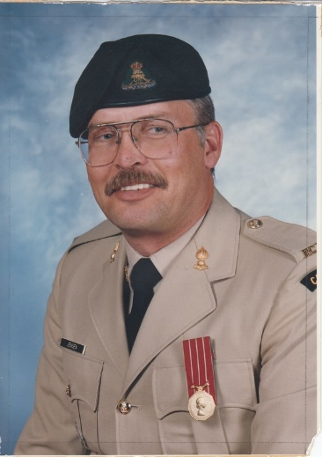
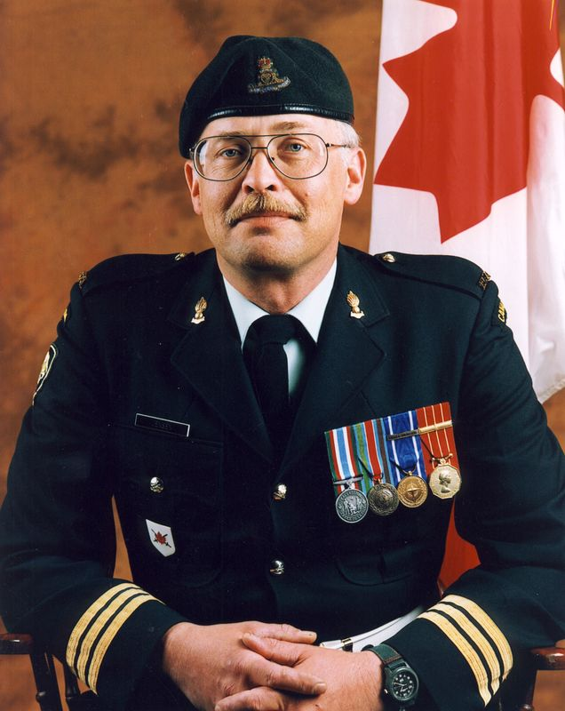
Leon Jensen OMM CD
Enrolled 15th Field Artillery Regiment RCA Oct 1970
Regimental Sergeant Major 1986-1988
Commanding Officer 1998-2001
President Vancouver Artillery Association
Vice-President Royal Canadian Artillery Association
Webmaster – www.vancouvergunners.ca

Slide 2
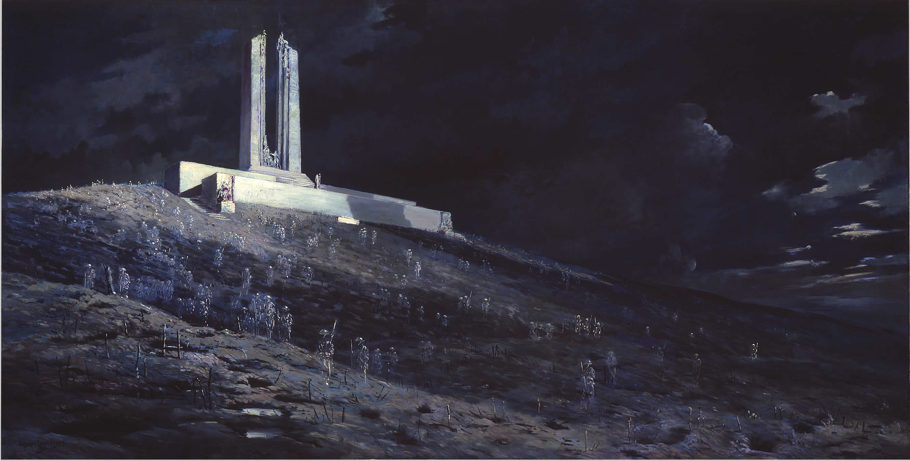
World War I – The War to end all Wars

Slide 3
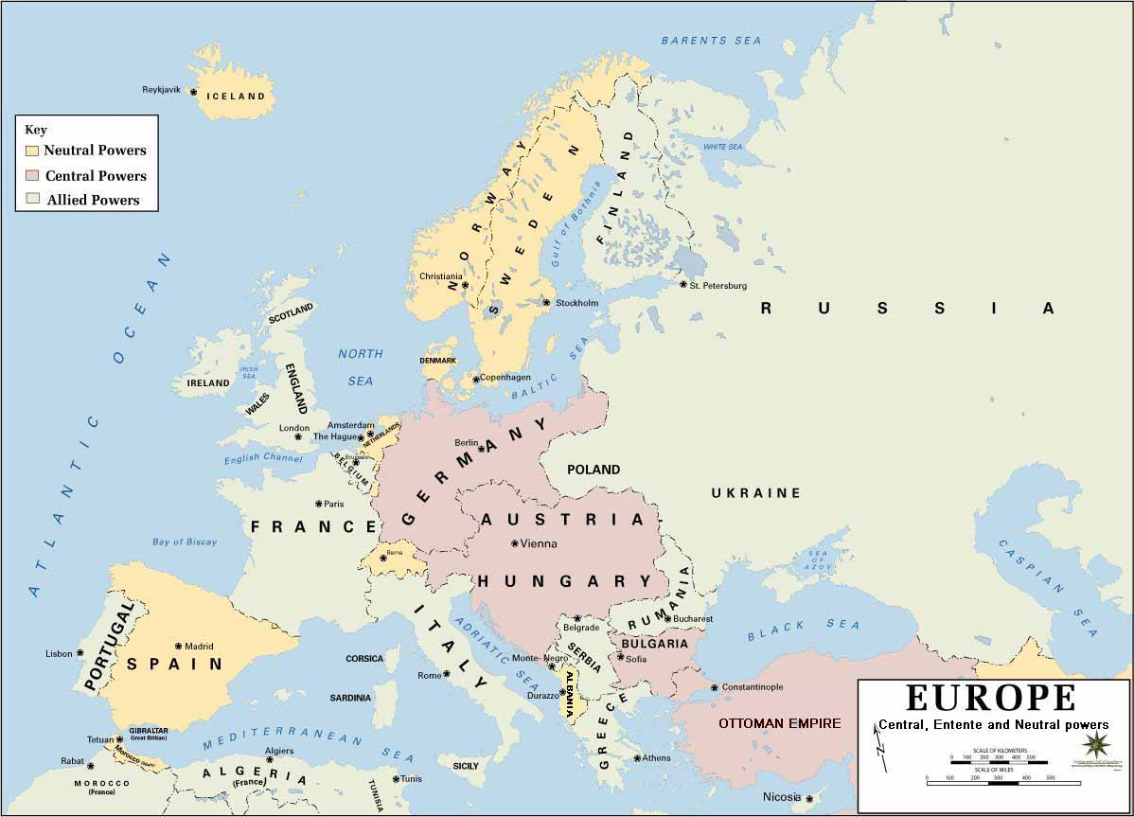

Slide 4
On Sunday, June 28, 1914, Archduke Franz Ferdinand, heir to the Austro-Hungarian throne, was shot and killed by a Serbian nationalist during a visit to Sarajevo in Bosnia.
Austria-Hungary, supported by Germany, sent a harsh ultimatum to Serbia.
Although Serbia met nearly every demand, Austria-Hungary declared war.
Russia, the self-proclaimed protector of the Slav nations, mobilized.
Germany demanded promises of peace from Russia and France
When there was no answer, Germany declared war
France looked to Britain for support
The German Army on its way to France invaded neutral Belgium
Britain sent an ultimatum demanding withdrawal of German troops
Britain was at war when no answer was received
And when Britain was at war, Canada was at war.

Slide 5
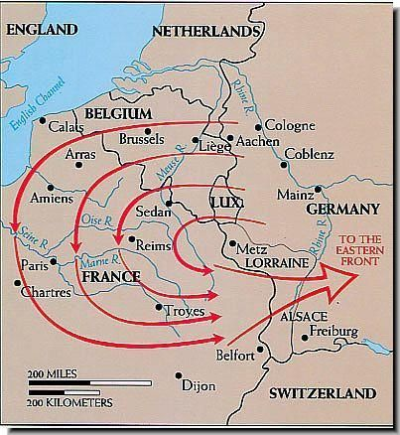

Slide 6
With a regular army of only 3,110 men and a fledgling navy, Canada was ill-prepared to enter a world conflict.
Within a few weeks more than 32,000 men gathered at Valcartier Camp near Quebec City; and within two months the First Contingent, Canadian Expeditionary Force, was on its way to England in the largest convoy ever to cross the Atlantic

Slide 7
The first Canadian troops to arrive in France were the Princess Patricia's Canadian Light Infantry, which had been formed at the outbreak of war entirely from ex-British Army regular soldiers. The "Princess Pats" landed in France in December 1914 with the British 27th Division.
February 1915, the 1st Canadian Division reached France.
September 1915, the 2nd Canadian Division joined the 1st.
The Canadian Corps was born.
December 1915 brought the 3rd Canadian Division.
November 1916 brought the 4th Canadian Division.
"The Canadians," wrote Lloyd George, "played a part of such distinction that thenceforward they were marked out as storm troops; for the remainder of the war they were brought along to head the assault in one great battle after another. Whenever the Germans found the Canadian Corps coming into the line they prepared for the worst."

Slide 8
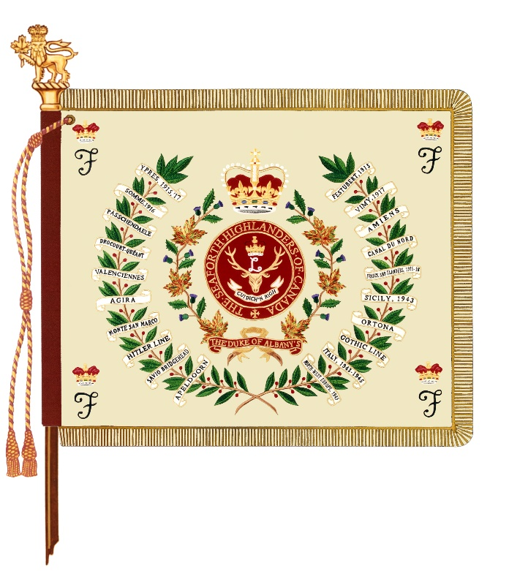
Battle Honours
Ypres, 1915
Gravenstafel
St. Julien
Frezenberg
Bellewaarde
Festubert, 1915
Mount Sorrel
Somme, 1916
Albert (Beaumont Hamel), 1916
Bazentin
Pozières
Flers-Courcelette
Thiepval
Le Transloy
Ancre Heights
Ancre, 1916
Arras, 1917
Vimy, 1917
Arleux
Scarpe, 1917
Hill 70
Ypres, 1917
Pilckem
Langemarck, 1917
Menin Road
Polygon Wood
Broodseinde
Poelcappelle
Passchendaele
Cambrai, 1917
Somme, 1918
St. Quentin
Bapaume, 1918
Rosières
Arras, 1918
Avre
Lys
Bailleul
Kemmel
Amiens
Arras, 1918
Scarpe, 1918
Drocourt-Quéant
Hindenburg Line
Epéhy
Canal du Nord
St. Quentin Canal
Beaurevoir
Cambrai, 1918
Ypres, 1918
Valenciennes
Sambre
Pursuit to Mons
Courtrai
Gallipoli, 1915-16
Egypt, 1915-16
Siberia, 1918-19

Slide 9
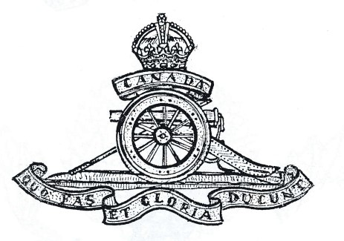
Did The 15th Field Artillery Regiment RCA participate in the First World War?
The 15th Brigade Canadian Field Artillery, consisting of the 60th, 61st, 62nd and 79th Batteries was part of the 4th Canadian Divisional Artillery prior to March 1917.
It was then reorganized into the 5th Canadian Divisional Artillery with the 54th, 81st and 82nd Batteries.
On deployment to France, The 15th Brigade was split up and its members were used to provide sections to the extant Artillery Corps.

Slide 10
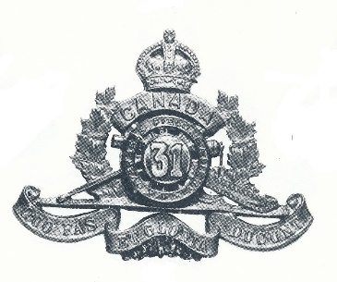
31st Battery, 8th Brigade Canadian Field Artillery
Organized in June 1915 in Hamilton, ON
Arrived in England 14 February 1916
Arrived in France 14 July 1916
Demobilized March 1919
Vimy Ridge, Hill 70, Passchendaele, The Somme

Slide 11
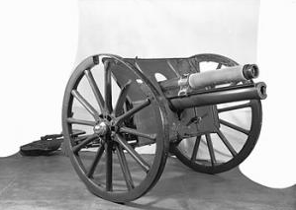
31st Battery, 8th Brigade Canadian Field Artillery
The Ordnance Quick Firing 18 Pounder was a quick-firing horse-drawn field gun designed to be towed behind a limber and six horses.
Shell weight - 18.5 lb (8.4 kg) projectile
Armour piercing, Smoke, Gas, Star, Incendiary, Shrapnel shell, High explosive
Range - 5966 m, 7100 m, 8500 m, 10100 m

Slide 12
5th Canadian Siege Battery, Canadian Garrison Artillery
Organized in June 1915 in Horsham, England as 165th Siege Battery
Arrived in France 21 September 1916
Redesignated 5th Canadian Siege Battery on 29 January 1917
Demobilized at Vancouver in May 1919
Vimy Ridge, Hill 70, Passchendaele, The Somme

Slide 13
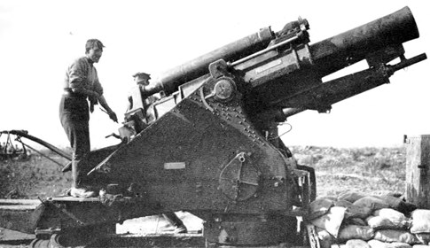
5th Canadian Siege Battery, Canadian Garrison Artillery
The Breech-Loading 9.2” Howitzer was a heavy siege howitzer transported in three loads - body and cradle, bed, barrel - towed by either heavy horses or a Holt tractor.
Shell weight - 290 Lb projectile
High explosive
Range - 9200m, 12742 m

Slide 14
11 November 1918
Canada's total casualties - 67,000 killed / 250,000 wounded.
Armistice Day created in 1919 – changed to Remembrance Day in 1931
We are the Dead. Short days ago We lived, felt dawn, saw sunset glow, Loved, and were loved, and now we lie In Flanders Fields
Lieutenant Colonel John McCrae

Slide 15
68th Battery, 16th Brigade Canadian Field Artillery
Organized in August 1918 in Witley, England
Left Dundee 21 September 1918
Arrived at Archangel 1 October 1918
Returned to England 22 August 1919
85th Battery Canadian Field Artillery
Organized in September 1918 in Petawawa, ON
Left Canada 22 December 1918
Arrived at Vladivostok 12 January 1919
Returned to Canada 30 May 1919

Slide 16
Lest we forget
Gunner Charles Gregg 68th Depot Bty 1 Jan 1917 2nd Div Ammunition Col KIA Barlin Military Cemetery, France
Lieutenant Laurence Henderson Gass 5th Canadian Siege Bty, CGA 8 Apr 1917. 5th Canadian Siege Bty, CGA Died of wounds Barlin Communal Cemetery, France
Gunner Thomas Leroy Chambers MM 31st Bty, 8th Brigade, CFA 8 May 1917 31st Bty, 8th Brigade, CFA Died of wounds Barlin Communal Cemetery Ext, France.
Gunner Roland Francis Turner 5th Canadian Siege Bty, CGA 26 Jun 1917 5th Canadian Siege Bty, CGA KIA Cabaret-Rouge British Cemetery, France
Lieutenant James Kay 5th Canadian Siege Bty, CGA 26 Jun 1917 5th Canadian Siege Bty, CGA KIA Cabaret-Rouge British Cemetery, France
Gunner Gordon Alexander Ferguson 5th Canadian Siege Bty, CGA 19 Jul 1917 5th Canadian Siege Bty, CGA Died of wounds Longuenesse Souvenir Cemetery, France
Gunner Gabriel Augine Leblanc 5th Canadian Siege Bty, CGA 21 Aug 1917 5th Canadian Siege Bty, CGA Died effects of gas Étaples Military Cemetery, France.
Gunner Arthur Burgess 5th Canadian Siege Bty, CGA 9 Oct 1917 5th Canadian Siege Bty, CGA Accidental explosion Cabaret Rouge British Cemetery, France
Lieutenant Albert Alexander Allen 68th Depot Bty 11 Oct 1917 46th Sqn Royal Flying Corps KIA Hon Artillery Company Cemetery, France
Gunner Leonard Duncan Haslett 15th Brigade, CFA 1 Nov 1917 6th Brigade CFA KIA Vlamertinghe New Military Cem, Belgium
Lieutenant James Maxwell McIlquham MC 31st Bty 9th Bde 6 Nov 1917 31st Bty 9th Brigade Died of wounds Nine Elms British Cemetery, Belgium
Gunner William Joseph Curran 5th Canadian Siege Bty, CGA 1 Jan 1918 5th Canadian Siege Bty, CGA Pneumonia Lillers Communal Cemetery, France
Lieutenant Lawrence Caffrey 15th Brigade, CFA 7 Mar 1918 8th Brigade CFA Accidental death Ecoivres Military Cemetery, France
Second Lieutenant Arthur William Aird 15th Brigade, CFA 23 May 1918 209th Sqn Royal Flying Corps KIA Arras Flying Services Memorial, France
Major Thomas Duncan Ringwood 15th Brigade, CFA 10 Aug 1918 60th Bty 14th Bde CFA KIA Cerisy-Gailly Military Cemetery, France
Gunner David Dickinson 68th Depot Bty 19 Sep 1918 1st Siege Bty CGA. KIA Cabaret-Rouge British Cemetery, France
Gunner Budd Arthur Addison 68th Depot Bty 24 Sep 1918 Ammunition Column, SEF Training accident Mountain View Cemetery, Vancouver, BC
Second Lieutenant William Jermy Jephson 15th Brigade, CFA 26 Sep 1918 175th Brigade RFA KIA Athies Communal Cemetery Ext, France
Lieutenant Claude Melnot Wilson DFC 68th Depot Bty 14 Oct 1918 29th Sqn Royal Flying Corps KIA Dadizeele New British Cemetery, Belgium
Gunner Frank H. Russell 68th Bty 16th Brigade 13 Nov 1918 68th Bty 16th Brigade KIA Archangel Allied Cemetery, Russia
Acting Bombardier David Fraser 68th Bty 16th Brigade 13 Nov 1918 68th Bty 16th Brigade KIA Archangel Allied Cemetery, Russia
Captain Oliver Alexander Mowat MC 68th Bty 16th Brigade 27 Jan 1919 68th Bty 16th Brigade KIA Cambellton Rural Cemetery, NB

Slide 17
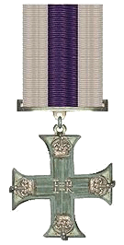
Military Cross
Captain C.R. Burton, MC
Lieutenant Joseph Gordon Chutter, MC
Lieutenant Arthur J. Cowan, MC
Lieutenant N. Hess, MC
Lieutenant H. Jones, MC
Lieutenant James Maxwell McIlquham, MC
Lieutenant Vincent McKenna, MC
Major Harry Lyall McPherson, MC
Captain H. Morton, MC
Captain Oliver Alexander Mowat, MC
​​Captain William Augustus Richardson, MC
Lieutenant J. Roberts, MC
Lieutenant Donald Graham Robertson, MC
Warrant Officer Class I Sverre Sorenson, MC
​Lieutenant William Allen Townsley, MC
Captain F.C. Whitehead, MC
Captain A.L. Wilson, MC
Lieutenant Douglas J Winslow, MC

Slide 18
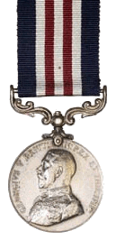
Military Medal
​Sergeant J.A. Beddow, MM
Signaller J.P. Breiter, MM
Signaller Thomas Leroy Chambers, MM
Bombardier William Osser Cook, MM
​Sergeant Edward Arlett Dickie, MM
Driver W.J. Donahue, MM
Gunner Sydney Phillip Fielding, MM
Warrant Officer Class I Herbert Hankins, MM
Gunner J. McLean, MM
Gunner W.J. Perryman, MM
Corporal Edward Savage, MM
Sergeant John Simmons, MM

Slide 19
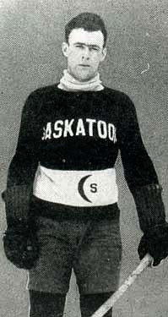
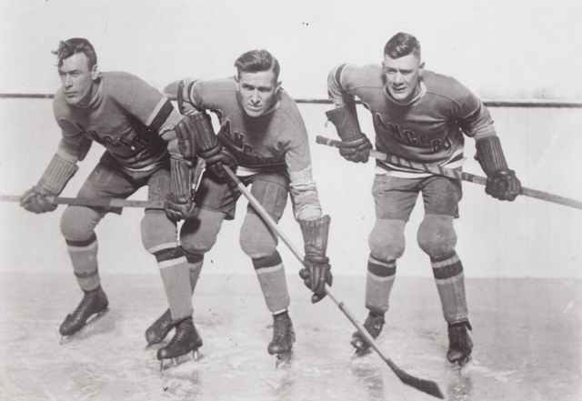
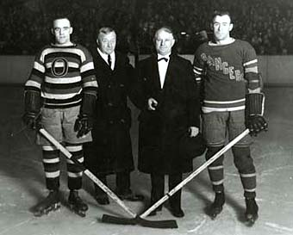
Bombardier William Osser Cook; Attested in 46th (Queen's) Battery 9th Brigade Canadian Field Artillery 5 Dec 1915, embarked Halifax 4 Feb 1916, disembarked Plymouth 14 Feb 1916, 11th Brigade Canadian Field Artillery, landed in France 15 Jul 1916, appointed Acting Bombardier 19 Jul 1916, reverts to Gunner at own request 11 Oct 1916, admitted hospital 27 Jan 1917, rejoined unit 2 Mar 1917, transferred to 9th Brigade Canadian Field Artillery on reorganization 25 Mar 1917, granted 14 days leave 21 Nov 1917, admitted to hospital whilst on leave 4 Dec 1917, transferred to Canadian Artillery Reinforcement Depot 4 Dec 1917, appointed Acting Bombardier whilst doing duties of same 27 Apr 1917, attached to Canadian School of Gunnery 5 Mar 1918, taken on strength Canadian School of Gunnery 27 Apr 1918, reverts to Driver on being spec employed 19 Aug 1918, taken on strength Composite Brigade Canadian Reserve Artillery 19 Aug 1918, taken on strength 16th Brigade Canadian Field Artillery 28 Aug 1918, appointed Acting Bombardier with pay 28 Aug 1918, proceeded overseas to Northern Russia 20 Sep 1918, arrived Archangel Russia 1 Oct 1918, served as a Driver in 68 Battery, awarded Military Medal in recognition of gallant conduct in field 8 Apr 1919, confirmed Bombardier 3 Jun 1919, embarked for United Kingdom 11 Jun 1919, embarked for Canada 5 July 1919, discharged 15 Jul 1919.

