Slide 1
The Royal Canadian Artillery Association / L’Association de l’Artillerie royale canadienne
Notes:
Serving the Guns since 1876

Slide 2
Our / Notre Mission
The promotion of the effectiveness and welfare of The Royal Regiment of Canadian Artillery and of all matters pertaining to the defence of Canada.
Promouvoir l’efficacité et le bien-être du Régiment royal de l’Artillerie canadienne et de toutes les préoccupations pertinentes à la défense du Canada.
Notes:
Letters and conversation to the MND regarding Artillery re-enactors, support for reserve employers,

Slide 3
Our / Notre Vision
An organization occupying a central position in the RCA Regimental Family; representative of all Canadian Gunners regardless of rank, whether serving or retired, regular or reserve; and, conducting its business in both official languages for the better good of the Regiment, its members and the defence of Canada

Slide 4
Éléments de la mission
Les éléments de la mission de l’AARC reflètent la stratégie familiale de L’ARC et se présentent comme suit:
Observer, supporter et promouvoir l’efficacité du Régiment;
Entretenir le Régiment en temps qu’une famille nationale et institutionnelle;
Célébrer et sauvegarder le patrimoine du Régiment; et
S’apparenter aux Canadiens
Notes:
The elements of the RCAA’s mission are reflective of the RCA family Strategy and are stated as:
Monitor, support and promote the effectiveness of the Regiment
Nurture the Regiment as a National Family and Institution
Celebrate and safeguard our Regimental heritage
Connect with Canadians

Slide 5
Who are we?
Qui sommes nous
All serving Gunners / Tous les artilleurs en service
Retired Gunners / artilleurs à la retraite
Families of Gunners / familles d'artilleurs
Friends of Gunners / Amis des artilleurs

Slide 6
Who are we?
Qui sommes nous
I have long believed that the RCAA is the heart of the Regimental Family. I believe we all have a responsibility to ensure that heart is a healthy one and can maintain the body of the Royal Regiment. By working together we can get there.
Lieutenant -General (Retired) Michael Jeffery
Colonel Commandant
RCAA Annual Report 2013-2014

Slide 7
Who are we?
Qui sommes nous
“There is a sense, that the Association is
losing contact with its membership”
2000/2001 Annual Report
Notes:
Our registered membership has grown 100% since October 2019. Our vision is to grow another 100% this year. Please contact us and let us know what your expectations of your Association is.

Slide 8
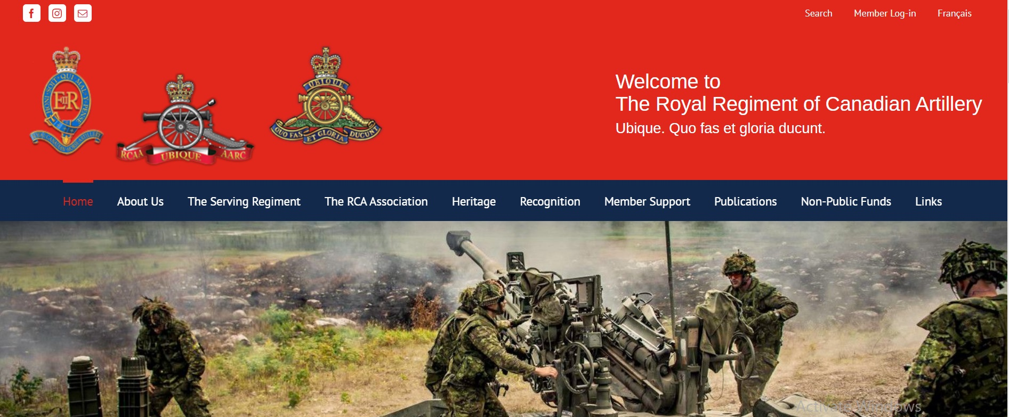
What benefits do we provide to our members?
Manage the Regimental website
rca-arc.org rca-arc.org/fr
Notes:
The RCA Association manages the rca-arc.org website. We’re always looking for input!

Slide 9
What benefits do we provide to our members?
Members Only Portal
Regimental Workspaces
Job bank
Online store
Event calendar
Member benefits
Notes:
We’ve starting turning on theses modules in the Member’s only portal.

Slide 10
Quels avantages fournissons-nous à nos membres?
Publish the monthly newsletter
Canadian Gunner News/
Les Nouvelles des artilleurs canadiens
Notes:
Tne Association needs your stories! Photos! editor.rcaa.aarc@gmail.com

Slide 11
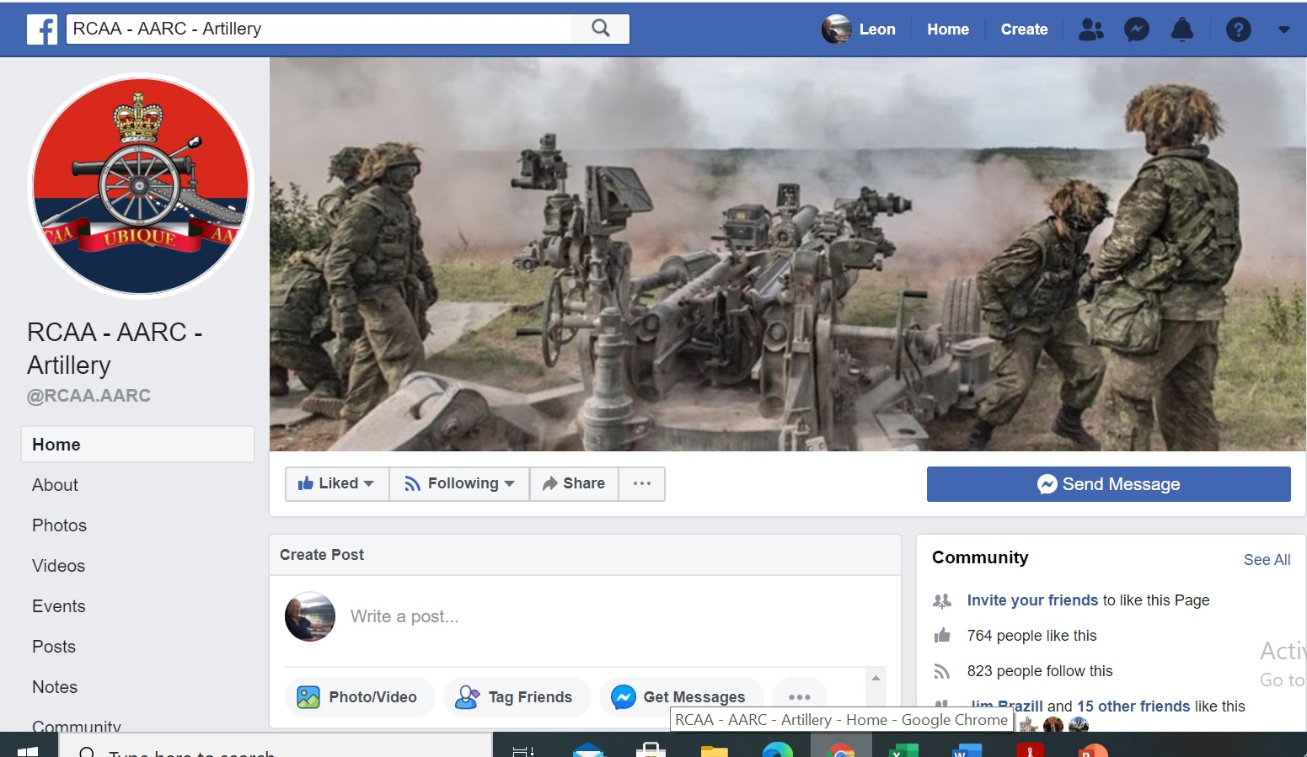
What benefits do we provide to our members?
Facebook
Notes:
Check it out! Share your stories! Share our stories!

Slide 12
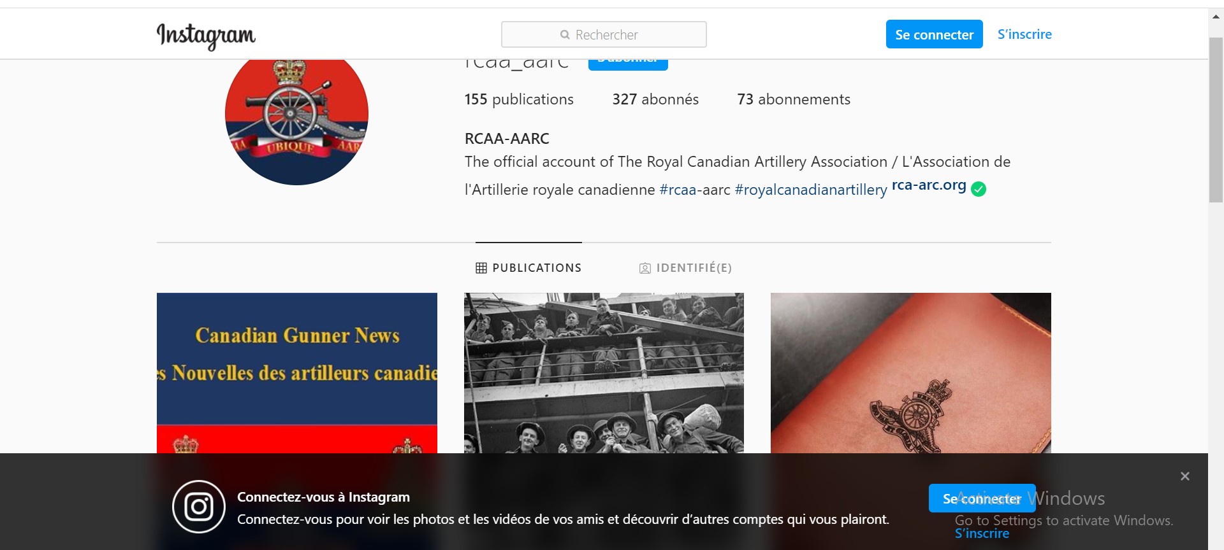
What benefits do we provide to our members?
Instagram
Notes:
Are we linked on Instagram yet?

Slide 13
Quels avantages fournissons-nous à nos membres?
The Gunner Peer Support Program /
Programme de Soutien des pairs artilleurs
Notes:
Once a Gunner, always a Gunner. Contact us if you hear of a Gunner in need.

Slide 14
Quels avantages fournissons-nous à nos membres?
Les bourses d’études
Bourse commémorative du capitaine G.R.E. Nicholls pour l’éducation postsecondaire
Bourse du lieutenant-colonel Jack de Hart MC CD
Bourse du maître artilleur E.M. «Chip» Evoy MM & Bar
Notes:
Check them out on the website http://rca-arc.org/awards/regimental-awards/the-captain-generals-diamond-jubilee-bursary/

Slide 15
What benefits do we provide to our members?
Annual Effectiveness Report
The committee has been collecting data since 2006 with the intent to leverage data to give a view over time.
Notes:
What was the Regiment doing 14 years ago? How many rounds were expended? What was our strength at?

Slide 16
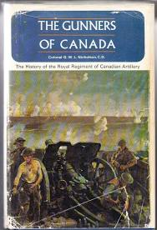
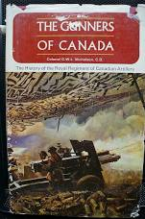
Quels avantages fournissons-nous à nos membres?
Publications
Les artilleurs du Canada Vol III – L’histoire autorisée du Régiment royal de l’Artillerie canadienne de 1967 à 2014
Notes:
Volume III currently in the works with publication expected during UBIQUE 150

Slide 17
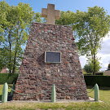
What benefits do we provide to our members?
Canadian Corps Artillery Monument
Thélus, France
Notes:
The Rca Association has been maintaining the Thelus monument and has just, this year, completed a major facelift. In negotiation to turn over to Veteran’s Affaisr for their upkeep.

Slide 18
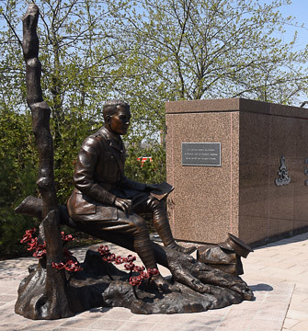
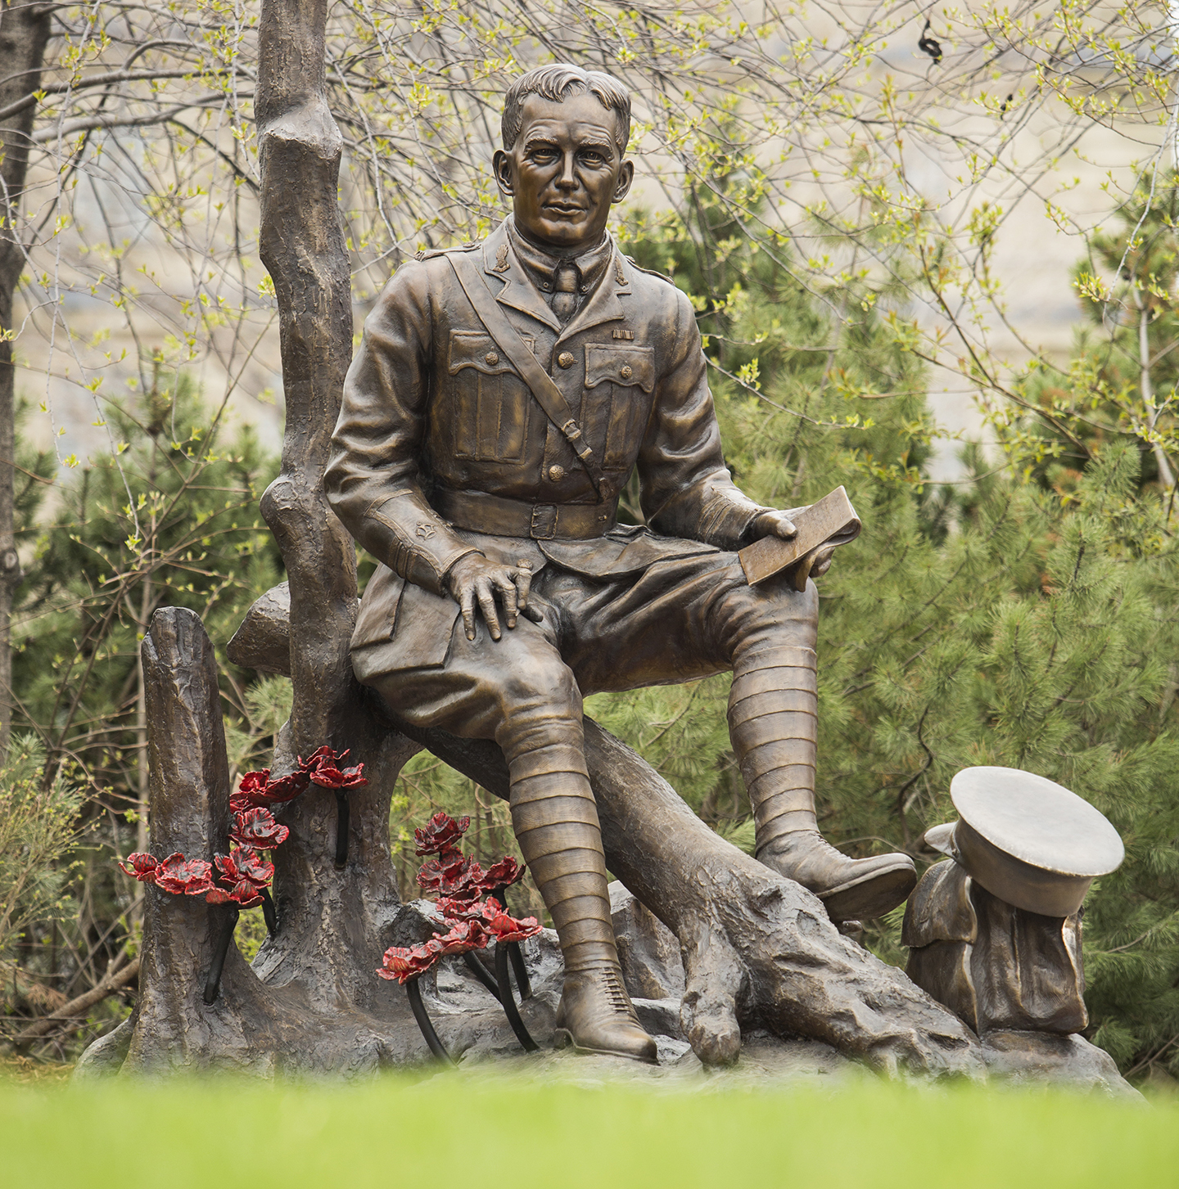
What benefits do we provide to our members?
Lieutenant-Colonel John McCrae Statue
Ottawa, ON
Notes:
Major fundraiser for historical monuments.

Slide 19
What benefits do we provide to our members?
Defence Advocacy
Supported Military Leave for Reservists
Advocating on behalf of our re-enactors

Slide 20
What benefits do we provide to our members?
Affinity Programmes
Notes:
Compare rates! The RCA Association receives a commission which goes toward our GPS and other programs.

Slide 21
Future Events
AGM – October 2020
Special General Meeting – May 2021
Support to Ubique 150

Slide 22
What can you do for us? / Que pouvez-vous faire pour nous?
Have your members register!

Slide 23
What can you do for us? / Que pouvez-vous faire pour nous?
Encourage your members to register.
Encourage your retired members to join.
Have your local Association connect with us.
Submit stories for the monthly newsletter.
Provide RHQ RCA with your monthly SITREPs.
Check out the TD Insurance products.

Slide 24
Questions?

